Slide 1

Project 20
Thermistor

Slide 2
1
2
3
Introduction
Components Required
Component Knowledge
4
5
6
Read the Values
Find the
Command Blocks
Combine the
Command Blocks
7
Result

Slide 3
1.Introduction
Thermistor is a kind of resistor whose resistance depends on temperature changes. Therefore, we can use this feature to make a temperature instrument. In this project, we read the correlation values of the thermistor by a serial monitor.

Slide 4
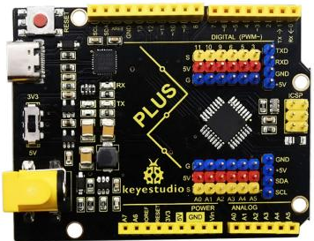


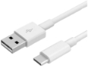
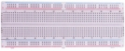
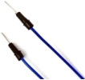
2.Components Required
Keyestudio Plus Mainbaord*1 | Thermistor*1 | Breadboard*1 | 4.7KΩ Resistor*1 | Jumper Wires
USB Cable*1

Slide 5
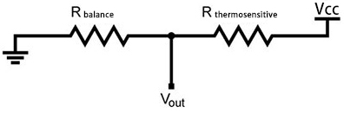
3.Component Knowledge
Thermistor: A thermistor is a temperature sensitive resistor. When it senses a change in temperature, the thermistor's resistance changes. We can use this feature to detect temperature intensity with thermistor. This is widely used in gardening, home alarm systems and other devices.
① The NTC-MF52AT 10K thermistor is used here, where B is 3950 and it is connected in series with RS (RS=R_{balance}=4.7KΩ resistor). The resistance value of the thermistor changes as the temperature changes.

Slide 6
②Calculation of NTC thermistor:
Calculation formula: Rt = R*EXP[B*(1/T1-1/T2)]
Among them, T1 and T2 refer to K degrees, that is, Kelvin temperature.
Rt is the resistance of the thermistor at T1 temperature.
R is the nominal resistance of the thermistor at T2 room temperature. The value of the 10K thermistor at 25℃ is 10K (R=10K). T2 = (273.15 + 25).
EXP[n] is the nth power of e.
B is an important parameter of the thermistor, B equals 3950.
(Continued on the next page)

Slide 7
We can use the values measured by the ADC converter to get the resistance values of the thermistor, and then use the formula to get the temperature values.
t=((T1*B)/(B+T1*ln(Rt/R1)))-273.15，“ln”can be converted to “log”, that is, t=((T1*B)/(B+T1*log(Rt/R1)))-273.15. Error is ±0.5.

Slide 8
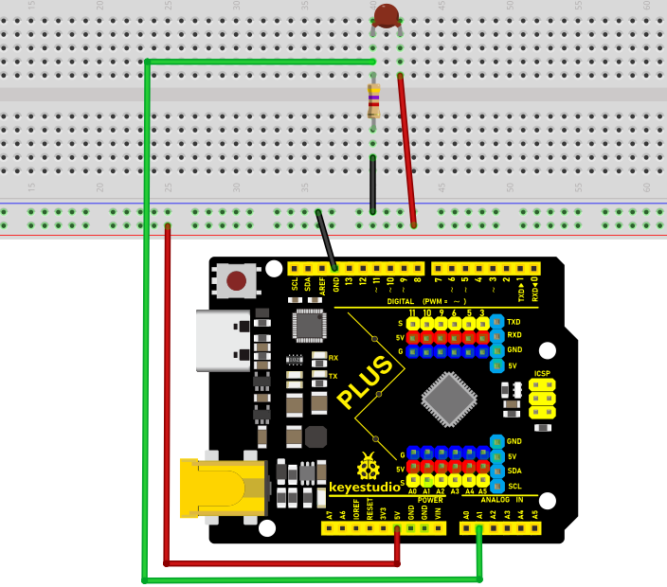
4.Read the Values
First we have learned how to use the serial monitor to print the thermistor values. Please wire up according to the following wiring diagram.

Slide 9
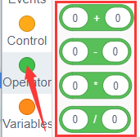
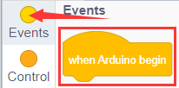
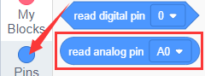
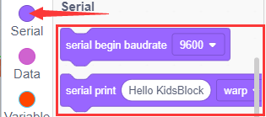
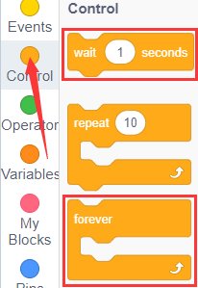
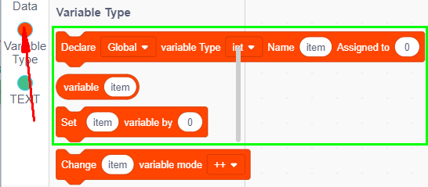
5.Find the Command Blocks

Slide 10
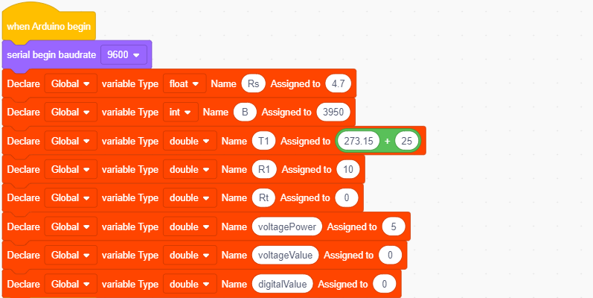
6.Combine the Command Blocks
(Continued on the next page)

Slide 11
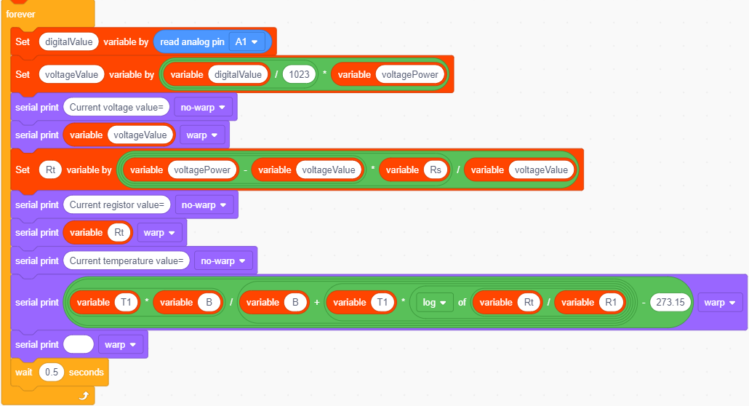

Slide 12
7.Result
1.Connect the components according to the wiring diagram, and wire the mainboard with a computer via a USB cable.
2.Select the corresponding mainboard and port(COM) on the Kidsblock.
3.Click the "Upload" button on the Kidsblock to upload the code.
(Continued on the next page)

Slide 13

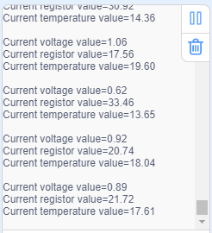
7.Result
4.After burning the project code and powering up,click in the serial monitor and set the baud rate to 9600. Then we can read the voltage values of the pin A1 on the thermistor，obtain the resistance values and the temperature values of the thermistor through the voltage division ratio. As shown below.

Slide 14


